Slide 1
Collecting and Refining the Dataset
Collect the Dataset
Analyze the Dataset to Gain Insights
Use Visualizations to Analyze Data
Prepare Data

Slide 2

Collect the Dataset

Slide 3
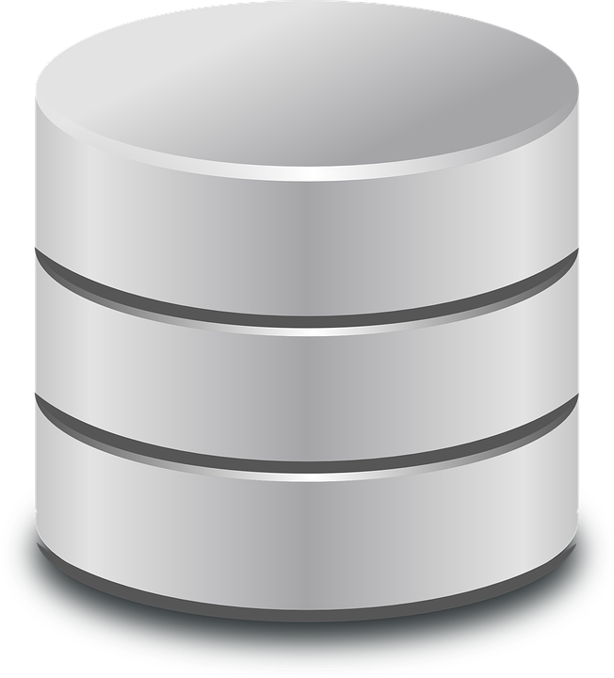
Machine Learning Datasets
May need to be collected just once, or on a recurring basis.
One-time analysis of a historical dataset
Company’s own data – e.g., manufacturing production records, business databases, surveys, or marketing records
Third-part data – e.g., medical research data, census reports, or public records that you have downloaded from a government website
Ongoing analysis of incoming data, such as:
Data collected by IoT sensors
Sales transaction records
System logs
May be in different formats, such as:
JSON
CSV
XML
Relational database/SQL
When you must collect and prepare data on a recurrent basis, it is beneficial to develop scripts to automate processes that download, convert, and combine data coming in from various sources.
Datasets

Slide 4
Structure of Data
Data used in machine learning may be:
Structured
Facilitates searching, filtering, or extracting data
As in a spreadsheet or database, data categories are separated and/or labeled
Specific chunks of data (height, age, first name, last name) can be easily retrieved for any record
Unstructured
Not as easy to query – for example, images, video, audio files, data on social media sites, email
Nonetheless, a very important source of information in machine learning
Often represents a much larger portion of a business's data than structured data
Semi-structured
Email documents contain some structure, even if the body of content they contain does not
Fields associated with the sender, recipient, send date, and so forth
Can be directly searched, filtered, and extracted
In ML, data sources such as XML and JSON documents may be treated as either structured or unstructured
Depends on the consistency of their structure and content
Consistent: Machine-authored documents such as logging output from a server or application
Inconsistent: Some human-authored documents

Slide 5
Terms Describing Portions of Data
Attribute
Column/field
House ID | price | square_feet | bedrooms
00323 | $549,000 | 5500 | 8
00356 | $329,000 | 2900 | 5
00451 | $99,500 | 1200 | 2
bedrooms=5
Feature
Row/record
Data item/value

Slide 6

Data Quality Issues
Even very simple machine learning algorithms can perform as well as much more advanced and complex algorithms if provided with large amounts of good data.
To produce a good machine learning model, it is essential to start with a good training dataset.
When you select and prepare datasets for machine learning, there are numerous issues you’ll have to consider regarding the quality of the dataset.
Sufficient Quantity
Relevant Features
Representative
Errors, Outliers, and Noise
Datasets

Slide 7
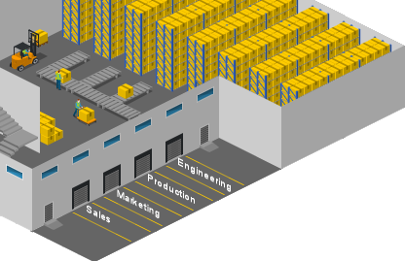



Data Sources
Data Warehouse
Relational Database
Structured data
Used for BI, batch reporting, data visualization
Relational data captured from applications, transactional systems, operations databases
Structured, normalized data
Used by applications to capture transactions
Single data source
Data Mart
Operational Data Store
Data Lake
Structured data
Used by a particular department or business function to support analytics
Subsection of the warehouse
Structured data
Used in operations
Captured from enterprise applications, other sources
May feed into data warehouse
Widely varying data structure and sources
Used for ML, big data analytics, predictive analytics, data discovery
Copyright © 2020 CertNexus, Inc. All rights reserved.

Slide 8


Open Datasets
University of California Irvine Machine Learning Repository
Kaggle Datasets
Amazon Datasets
Microsoft Research Open Data
Open Media Library (OpenML)
Government Repositories

Slide 9

Select a Machine Learning Dataset
Identify what you want to predict, so you can decide what data you need to collect.
Consider all data sources within your organization.
Consider using third-party data when you don't have your own data.
Establish repeatable mechanisms for collecting data.
Collect "right data," not necessarily "big data."

Slide 10
Activity: Examining the Structure of a Machine Learning Dataset
You are developing a real estate pricing tool for CapitalR Real Estate company.
You have proposed a model that will:
Be trained using attributes such as the size of the home, the number of bathrooms and bedrooms, and location
Output the house’s price (the dependent variable)
Determine (predict) the price through multiple inputs (independent variables)
Use regression
You have found a dataset you can use to train the machine learning model.
CSV file
Contains more than 20,000 real estate transactions
King County, Washington
Before you start writing code to load this dataset in Python for analysis and manipulation, you will preview the contents of the data file.

Slide 11
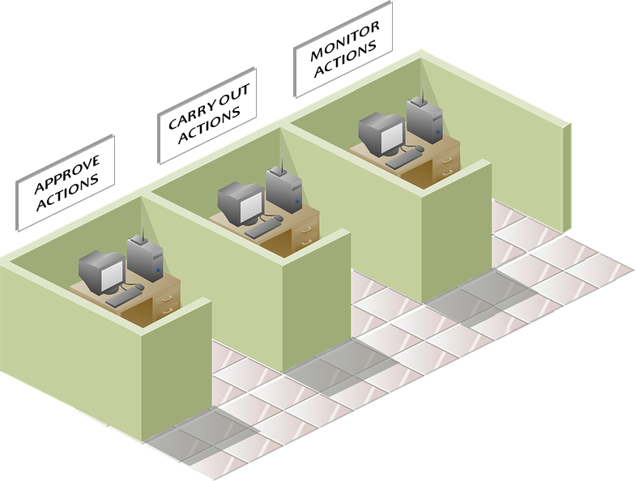
Extract, Transform, and Load (ETL)
Even when original data sources are clean, problems may be introduced when data from different sources are combined.
Different databases may use different schemas to organize data.
Columns may be named differently.
Data values may be represented by different data types or encoding schemes.
Records may overlap or contain duplicate data.
Perform ETL to resolve these problems before you use the data in ML.
Extract—Pull data from various sources
Transform—Convert into a proper and uniform storage format or structure
Load—Insert into the destination where it will be stored for later modeling
EXTRACT
TRANSFORM
LOAD

Slide 12
Machine Learning Pipeline
Collect
Aggregate & Clean
Incorporate Into Models
Deploy
Machine learning often involves workflows that must be repeated over and over again, as new data is accumulated.
A machine learning pipeline:
Uses a DevOps approach
Automates various phases of the process
Makes the workflow repeatable
Enables you to optimize it for simplicity, speed, portability, and reusability

Slide 13
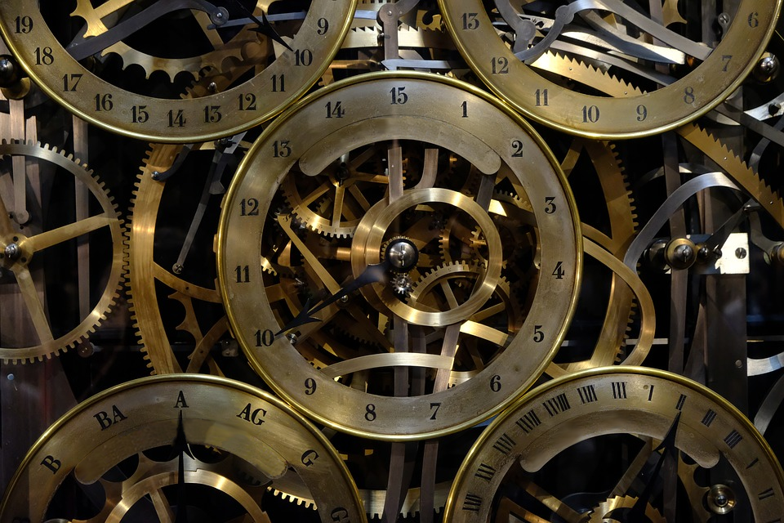
ML Software Environments
Often assembled from hundreds of different components
Host platform (such as Linux or Windows)
Programming environment (such as Python or R)
Online data repositories and cloud services
Software libraries used to accomplish different sorts of tasks (such as pandas, scikit-learn, and Matplotlib)
LOGISTIC REGRESSION
RANDOM FOREST
SUPPORT VECTOR MACHINE
These components (software libraries, in particular)
May have interdependencies that affect
Whether your projects will run
Results they produce
Carefully document the tools and versions your model uses, so you (or anyone who inherits your project) can reconstruct the correct environment later, if necessary.

Slide 14
Use Python to Load a Dataset
The pandas DataFrame object
Defines a two-dimensional labeled data structure that may contain columns of different types, similar to a spreadsheet or SQL table
Commonly used to import structured datafiles (such as JSON or CSV) for use in machine learning or data analysis projects
To load a dataset from a CSV file into a pandas dataframe:
import pandas as pd
my_dataframe = pd.read_csv( data_raw_file )
num_records = len(data_raw)
To read a CSV file into a dataframe:
Call pandas' read_csv method
Pass in the combined path and filename of the CSV file
You can determine the number of records (rows) that were loaded by calling the len( ) function to obtain the length of the dataframe.

Slide 15
Activity: Loading the Dataset
You have obtained a dataset in the form of a CSV file containing tens of thousands of real estate transactions made in King County, Washington.
Using Python and Jupyter Notebook, you will load this dataset into a pandas dataframe object, which you can then use to analyze and manipulate the data.

Slide 16
Analyze the Dataset to Gain Insights

Slide 17
Dataset Structure
Start analysis by getting familiar with:
Dataset content
Format of the various columns the dataset contains
Data type of each column
This will enable you to:
Start thinking about what you can do with the data
Determine what preparation you must do to prepare it for machine learning
Make sure features are numeric
Split combined data into separate columns
Convert data to common formats, character sets, scale, etc.
Helpful Python functions
Call dataframe info() function to list all of the dataset's attributes and data type of each
Call dataframe head() function to preview rows of data

Slide 18
Use Python to Summarize Data
Functions useful to summarize data in a pandas dataframe:
my_dataframe.info()
my_dataframe.head()
my_dataframe.describe()
pandas.option_context()
See https://pandas.pydata.org for full documentation of these functions.

Slide 19

Activity: Exploring the General Structure of the Dataset
You have loaded the real estate dataset.
Now you can use Python and various software libraries to get acquainted with the data.
It's helpful to know what kind of information is present in each column and the data types stored in those columns.
This will help you to start thinking about which columns will be useful to train your machine learning model, and whether you need to perform any sort of "cleanup" tasks before you set up the model.

Slide 20
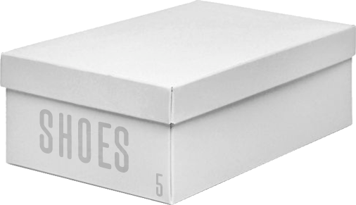

Normal Distribution
10,000
9,000
8,000
7,000
Number of Orders Placed
6,000
5,000
4,000
3,000
2,000
1,000
3
4
5
6
7
8
9
10
11
12
13
Shoe Size

Slide 21
Non-Normal Distributions
10,000
9,000
8,000
10,000
7,000
9,000
6,000
8,000
5,000
7,000
4,000
6,000
3,000
5,000
2,000
4,000
1,000
3,000
3
4
5
6
7
8
9
10
11
12
13
2,000
1,000
3
4
5
6
7
8
9
10
11
12
13
Skewed
10,000
9,000
8,000
7,000
6,000
5,000
4,000
3,000
2,000
Multi-modal
1,000
3
4
5
6
7
8
9
10
11
12
13

Slide 22
Descriptive Statistical Analysis
Enables you to view data the way ML algorithms view data
Involves various measures or descriptions you can use to summarize patterns and relationships in data using:
Numbers produced by mathematical calculations
Visualizations such as graphs or tables that help to reveal significant information
Provides insights that will:
Help you improve the dataset's usefulness in training a machine learning model
Lead to better performance in the machine learning models that you create
Concepts described through descriptive statistics include:
Central Tendency
Variability
Variance
Standard Deviation
Modality
Skewness
Kurtosis

Slide 23
Central Tendency
Measures concerned with what's going on in the middle of the dataset
Perfect normal distribution:
Has middle located the same distance from the right and left of the bell-shaped curve
Is not always the case, so it's useful to have various ways to measure center
Mean
Simple average of all numbers in the set
Calculated by adding all numbers, then dividing by the total count
Example: Within the set [12, 28, 41, 51, 68], the mean is 40.
Median
The number value located in the middle of a sorted set
Example: Within the set [12, 28, 41, 51, 68], the median is 41.
Mode
The number that occurs most often within a set of numbers
Example: Within the set [12, 14, 16, 16, 16, 17], the mode is 16.

Slide 24
When to Use Different Measures of Central Tendency
Measure | Most Useful For Describing
Mean | Continuous data in a symmetric distribution with no outliers
Median | Distributions that are skewed or that have outliers
Mode | Qualitative and categorical data—where data values are selected from a limited set such as {"for sale", "sale pending", "sold"} or {"public", "private"}

Slide 25
Variability
The extent to which data varies across all values in the dataset
Also called dispersion, scatter, or spread
Includes whether the distribution is stretched out widely among a range of different values or condensed among a group of very similar values
Common measures of statistical dispersion include:
Variance
Standard deviation
Interquartile range

Slide 26
Range Measures
Median
25% of the data values occur within each quartile
Q1
Q2
Q3
Q4
Interquartile Range
The middle 50% of data values

Slide 27
Variance and Standard Deviation
Mean
3 standard deviations away from the mean
Tightly Clustered
Dispersed
SD
SD
SD
SD
SD
SD
SD
SD
You might need to compare the variability of datasets containing different numbers of samples or datasets with a different central tendency.
To be most useful, then, a measure of variability:
Should represent the amount of variability (dispersion, scatter, or spread) in the data
Should not represent:
The number of samples in the data
The central tendency of the data
Both variance and standard deviation (which is based on variance) meet these requirements.

Slide 28

Calculation of Variance
$$σ^{2}=\frac{\sum{{\left(X−μ\right)}^{2}}}{N}$$
Variance of a population—Measures how far each value in the dataset is from the mean
Where:
σ² represents variance of a population.
Σ is the summation operator, meaning "add the following numbers."
X is the quantity measured in the data, such as house prices or the number of bedrooms.
μ is the mean, the average of all of the values in the set.
N is the number of values included in the set.
Calculated for a column of data by:
Finding the mean (average) of all values in the set.
For each number in the set, subtracting the mean and then squaring the difference.
Adding up all of the values you calculated in Step 2, and dividing by the number of values in the set to get the average.
Provides two benefits by squaring the difference (Step 2)
Gives more weight to values farther away from the mean.
Ensures that numbers less than the mean won't cancel out numbers greater than the mean.
Values that are less than the mean or greater than the mean will both have a positive influence on the measure of variance.

Slide 29

Variance in a Sample Set
$$s^{2}=\frac{\sum{{\left(X−\overline{X}\right)}^{2}}}{n−1}$$
Variance in a sample set—Measures how far each value in the dataset is from the mean
Where:
s² represents variance of a sample.
Σ is the summation operator, meaning "add the following numbers."
X is the quantity measured in the data, such as house prices or the number of bedrooms.
X̅ is the mean, the average of all of the values in the set.
n is the number of values included in the set.
Different formula for working with a sample set, a smaller group than the population.
Performs Bessel’s Correction:
Subtracts 1 from the total number of values in the sample.
Compensates for the lack of information that would be provided by the larger population.

Slide 30

Calculation of Standard Deviation
$$σ=\sqrt{\frac{{\sum{\left(X−μ\right)}}^{2}}{N}}$$
Standard deviation for an entire population—Measures variance
Where:
σ represents standard deviation of a population.
Σ is the summation operator, meaning "add the following numbers."
X is the quantity measured in the data, such as house prices or the number of bedrooms.
μ is the mean, the average of all of the values in the set.
N is the number of values included in the set.
If you have already obtained the variance, you can obtain the standard deviation simply by getting the square root of the variance. Or you can calculate standard deviation by:
Finding the mean (average) of all values in the set.
For each number in the set, subtracting the mean and then squaring the difference.
Adding up all of the values you calculated in Step 2, and dividing by the number of values in the set to get the average.
Taking the square root of the Step 3 result.
When working with a sample, you must adjust the formula for standard deviation like you adjust the variance formula, subtracting 1 from the number of values.

Slide 31
Skewness
Median
Mean, Median, and Mode
Median
Mode
Mean
Mean
Mode
Positive Skew
Symmetrical
Negative Skew

Slide 32


Skewness Measures
$${Sk}_{1}=\frac{\overline{X} −Mo}{σ}$$
Pearson’s skewness measures—Measure skew within a distribution
Where:
X̅ is the mean.
σ is the standard deviation.
Mo is the mode.
Md is the median.
$${Sk}_{2}=\frac{3\left(\overline{X} −Md\right)}{σ}$$
While the two formulas produce different values, you interpret the result the same way.
The sign of the result (positive or negative) identifies the direction of skewness. A positive value means the peak is shifted to the left, and a negative value means the peak is shifted to the right. Zero means no skewness at all.
The size of the result (how much it differs from zero) represents the degree of skewness from a normal distribution. Values farther away from zero represent more skewness.

Slide 33
Kurtosis
Leptokurtic
Mesokurtic
Platykurtic
Narrow (Kurtosis > 3)
Normal (Kurtosis = 3)
Flat (Kurtosis < 3)

Slide 34

Calculation of Kurtosis
$$a_{4}=\sum{\frac{{\left(X_{i}−\overline{X}\right)}^{4}}{{ns}^{4}}}$$
Kurtosis—Measures the shape of the tails in a distribution.
Where:
Xi is the ith X value in the dataset.
X̅ is the mean.
n is the sample size.
s is the sample standard deviation.
Measures the combined weight of the left and right tails relative to the center of the distribution.
3 = Mesokurtic—Normal bell-shaped distribution
<3 = Platykurtic—Bunched to the center, small tails dropping off quickly at the sides
>3 = Leptokurtic—Spread out with extended tails
Excess kurtosis
3 is subtracted from the kurtosis result to show a zero for normal (mesokurtic).
Platykurtic distributions would then be negative.
Leptokurtic distributions would be positive.
Kurtosis measurement may reveal outliers in your training data that you need to address before you fit the model.

Slide 35
Statistical Moments
First Moment—The mean, which identifies where numbers typically lie.
Second Moment—The numerator of the variance, which describes the spread or scale of the distribution of the normals.
Third Moment—The skewness, which describes the symmetry of the distribution.
Fourth Moment—The kurtosis, which describes the flatness or peakedness of the distribution.

Slide 36
Correlation Coefficient
Many ML algorithms look for correlations between data values. Example:
Correlation between the number of bedrooms in a home and the price the home sells for
If higher-priced houses tend to have more bedrooms, there is a positive correlation between bedrooms and price
Pearson correlation coefficient (PCC)
Provides a measure of linear correlation between two variables commonly called X and Y
Produces a value between +1 (positive correlation) and −1 (negative correlation)
Shows the strength of their dependence on each other
Positive Correlation
No Correlation
Negative Correlation
r = 0.3
r = 0
r = −0.5

Slide 37

Calculation of Pearson's Correlation Coefficient
$$r=\frac{n\left.\sum{xy} −\sum{x}\sum{y}\right.}{\sqrt{\left[n\sum{x^{2}−{(\sum{x})}^{2}}\right]\left[n\sum{y^{2}−{(\sum{y})}^{2}}\right]}}$$
Pearson's correlation coefficient—Measures the correlation between two series in a dataset.
Where:
r represents Pearson's correlation coefficient.
n is the number of pairs.
Σ is the summation operator.
x and y are the possibly dependent values.

Slide 38
Identify Noise within a Dataset
In machine learning, noise:
Takes on a number of forms that cause algorithms to misidentify patterns and get bogged down in unnecessary processing.
Results in an ineffective model.
When looking for noise in tables of training data, look in:
Specific data items
Missing, or contains an outlier
To fix: Correct anomalous data items or drop the record that contains them
Columns
May have little or no correlation to the target, or may be redundant since they are dependent on other columns that are already included in the model
To fix: Drop unnecessary columns from the training dataset
Rows
An unusual combination of data items within a particular row/record may defy the overall pattern established by data in other records, and may mislead the algorithm during training
May be hard to reveal by looking at individual statistical measures, and may be discovered through machine learning methods such as anomaly detection
To fix: Drop row/record from the training dataset

Slide 39

Reveal Outliers in a Dataset
Outliers in a dataset may be the target of some models, such as those detecting fraud or network intrusions.
In other cases, outliers may skew and mislead your initial analysis, hamper training, increase training time, and diminish the model's effectiveness.
To identify outliers in a training dataset:
Use statistics measures to reveal extreme values.
Use visualization tools to reveal extreme values.
Use machine learning algorithms to reveal outliers.
Confirm suspected outliers by removing them from the dataset, retraining the model, and testing its performance to see if their removal improves performance of the model.

Slide 40
Use Python to Analyze Correlations
The pandas library provides various functions you can call to get information about the data loaded within a dataframe.
my_dataframe.corr()—Returns a table showing the correlation coefficient (a floating point number) for each pair of columns in the dataframe. You can specify the type of correlation to be performed, with Pearson standard correlation being the default type.
my_dataframe.sort_values()—Sorts the values along either axis. You can specify a list of names to sort by and specify whether the sort should be in ascending or descending order. The function returns a dataframe with the values sorted. You can assign the return value back to the original dataframe if you want the original to contain the sorted results.
Complete documentation may be found at https://pandas.pydata.org.

Slide 41
Activity: Analyzing a Dataset Using Statistical Measures
You have explored the general structure of the dataset and have gotten familiar with the various columns of data, including the data type of each column.
Now you will examine various statistical measures as you continue considering which features may be useful to predict a house's optimum price.

Slide 42
Use Visualizations to Analyze Data

Slide 43
Visualizations
Depict patterns, trends, and correlations that might go unnoticed when the data is shown as a list of numbers, text, and other data values.
Provide insights and help communicate data outcomes.
Have been used for centuries, long before computers or ML came into use.
Can be useful at various points throughout an ML project, such as when you:
Initially explore data
Train and evaluate the model
Communicate results to stakeholders
Can help you and others engage with data quickly and meaningfully, in ways that are often not possible when data are represented only as columns and rows of data values.
Are often accomplished through plotting software such as a Matplotlib and Seaborn.
Can be quickly created in an interactive environment such as Jupyter Notebook to reveal patterns that might be worth exploring.
Can also help to expose data outliers, noise, and unexpected outcomes.

Slide 44
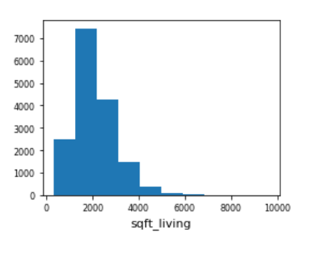
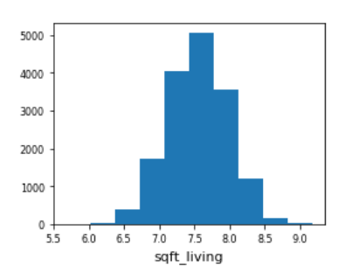
Histogram
Skewed
Symmetrical

Slide 45
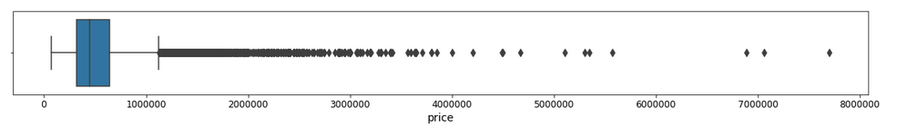
Box Plot
Minimum
Maximum
IQR
Outliers
Median

Slide 46
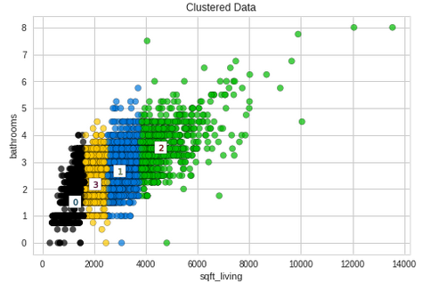
Scatterplot

Slide 47
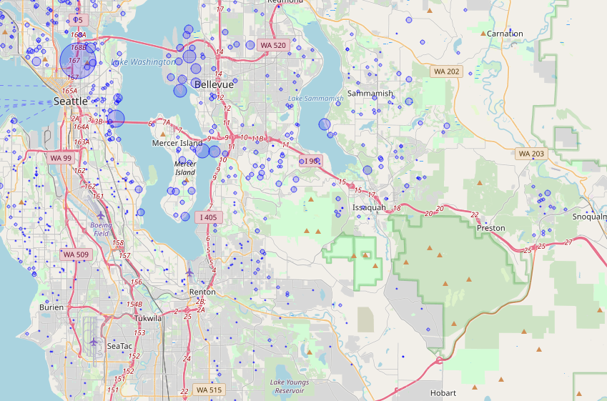
Geographical Maps

Slide 48
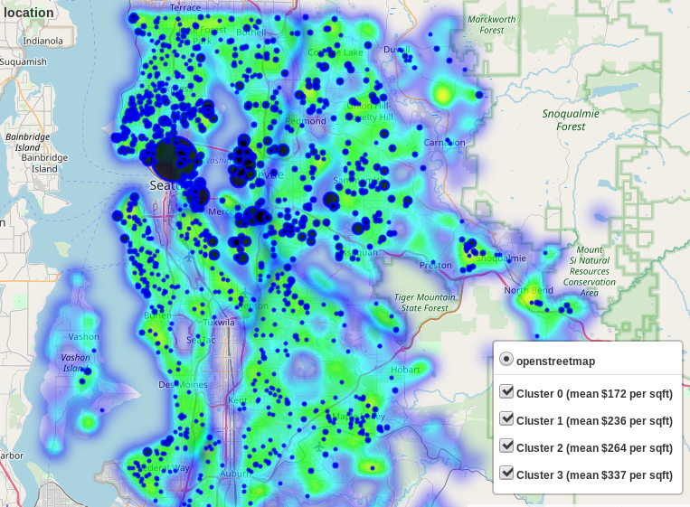
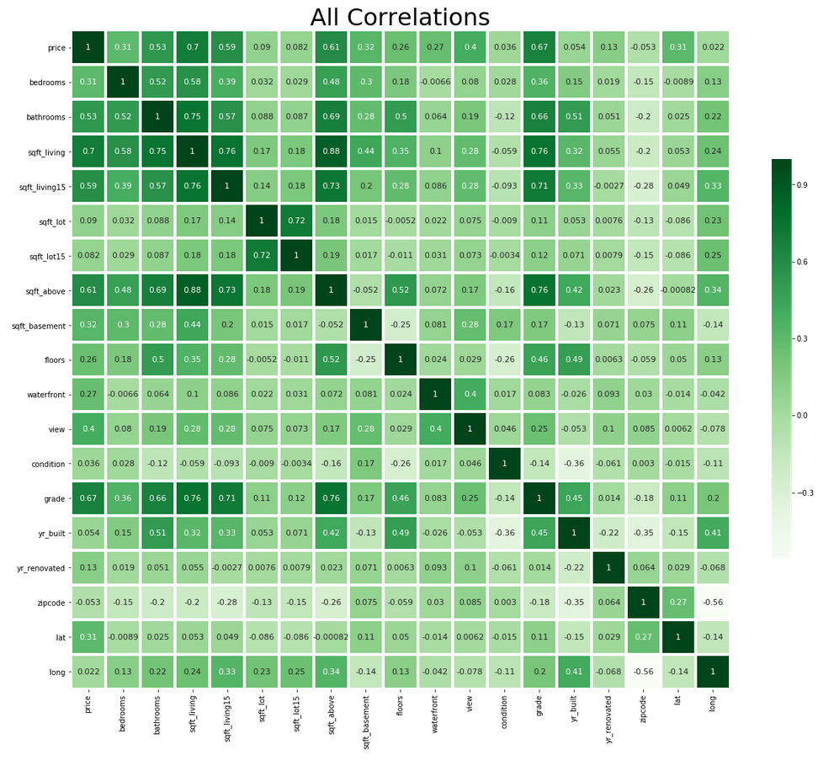
Heat Maps
Heat map superimposed on a geographic map
Areas with fewer houses are shown in purple. Regions with more houses are shown in green.
Correlation matrix shown in a heat map
Data pairs with lower correlation are shown in lighter shades. Data pairs with higher correlation are shown in darker shades.

Slide 49
Use Python to Generate Visualizations
matplotlib.pyplot.rc('axes', labelsize=14)
dataframe.hist( figsize=(20,15) )
matplotlib.pyplot.figure()
seaborn.heatmap()
matplotlib.pyplot.title()
matplotlib.pyplot.subplot()
Complete documentation may be found at https://matplotlib.org, https://pandas.pydata.org, and https://seaborn.pydata.org.

Slide 50
Activity: Analyzing a Dataset Using Visualizations
You have used various statistical measures to examine values in the dataset.
Now you will use visualizations (various types of charts) to gain additional insights regarding the data.

Slide 51
Prepare Data

Slide 52

Data Preparation
Data cleaning (also called data cleansing or scrubbing)
Locating and removing errors and inconsistencies in data
Removing or handling incorrect or missing data, outliers, and so forth
Standardize column names to make them consistent, readable, and understandable
Remove padding or embedded spaces
Feature engineering
Transforming columns of raw data in the original dataset into features that are useful to support machine learning is called feature engineering.
Examples: Extract combined values into separate columns, create a new column based on values in other columns.
Can be tedious and time consuming—sometimes called data wrangling or data munging, particularly when performed manually or outside of formal, repeatable processes.
Libraries such as pandas provide functions that enable you to automate data preparation.

Slide 53
Data Types
Data items may be represented differently in various sources:
Different data types and levels of precision.
Dates stored as string, datetime object, or number.
Values combined from multiple sources must be converted to a consistent data type and format to support the ML algorithms you're using to process the data.
Multiple data types combined within a single string should be split into columns with appropriate data types for each.

Slide 54
Operations You Can Perform on Different Types of Data
Type of Data | Description
Quantitative (or numerical) data | Hold number values. Various center and spread measures can logically be made. Valid measures for the quantitative dataset (18, 18, 29, 45, 59) are shown here. Mean - 18 + 18 + 29 + 45 + 59 / 5 = 33.8 Median - 29 Mode - 18 Range - 59 - 18 = 41
Qualitative (or categorical) data | Hold a value from a set of values that are typically limited. Example: Eye Color might hold colors such as blue, brown, or hazel. Most center and spread measures are inappropriate, although mode can still be determined. Valid measures for the qualitative dataset (blue, hazel, brown, brown, brown) are shown here. Mode – brown
Ordinal data | Not quantitative, but they can be ordered. Example: Letter Grade feature might hold a student's grade, which can be A, B, C, D, or F. An order is represented (for example, an A is a better grade than a C). Valid measures for the class dataset (A, B, C, F, F) are shown here. Median - C Mode - F

Slide 55

Continuous vs. Discrete Variables
Continuous variable: Data item whose values are uncountable and can extend infinitely.
Example: A person's age.
You might constrain this variable to be between 0 and 129.
You could describe someone as being 40 years old.
Or you can get more specific:
40 years and 3 months; or 40 years, 3 months, and 6 days; or, 40 years, 3 months, 6 days, and 19 hours.
Certain machine learning algorithms, especially decision-tree-based algorithms, cannot effectively work with continuous variables.
Discrete variable: Data item whose values are countable and limited, because there is a definite gap between each value in a range of values.
Example: “Age in years.“
Must be 0, 1, 2, 3, and so forth.
Cannot be divided into more precise values.
More amenable to many machine learning algorithms.

Slide 56
Data Encoding
Label encoding
One hot encoding
Binary encoding
Frequency-based encoding
Target mean encoding
Hash encoding

Slide 57
Dimensionality Reduction
Process of simplifying a dataset by eliminating redundant or irrelevant features.
Can help reduce the problem of tuning a model so closely to the training data that the model performs poorly on new data samples (a problem called "overfitting").
Can decrease computation time and alleviate storage space issues.
Feature selection
Select a subset of original features
Includes relevant and/or unique features
Excludes features deemed redundant or irrelevant to the problem
Provides subset used to train the model
Useful in datasets that have a disproportionately large number of features compared to actual data examples
Feature extraction
New features from original features, by combining multiple correlated features into one
Useful in computer vision applications like image processing
While the goal is to minimize the loss of useful data as much as possible, there is still a risk of this happening. Nevertheless, dimensionality reduction is almost always worth doing, especially with complicated, feature-rich datasets.

Slide 58

Impute Missing Values
Some algorithms can handle missing values on their own.
But when you initially explore the data:
It is best if you identify missing data
Decide exactly how you will deal with missing data
You’ll generally build better models if you don’t just ignore missing data
Dropping records with missing values
May be a bad choice, depending on how many records you must delete and what other data they contain
Imputing missing values
May be the best approach
Strategies include:
Mean imputation
Substitution
Hot Deck Imputation
Cold Deck Imputation
Regression Imputation
Stochastic Regression Imputation
DATA

Slide 59

Duplicates
May occur, depending on how data is collected or aggregated
Should be identified and removed so records are only represented once
SAME
SAME
SAME
SAME
SAME

Slide 60

Normalization and Standardization
Depending on how different attributes are represented, one attribute may have more weight than another.
Example
Dataset includes age values varying from 23 to 69 (years old)
Weight values varying from 105 to 332 (pounds)
Weight values may exert more influence than age since the weights are generally larger
Normalization and standardization are both techniques for ensuring that different attributes are measured according to a common scale.
Normalization example:
Divide ages so the youngest age is represented by 0 and the oldest age is represented by 1.
Similarly normalize the lowest weight to 0 and the highest weight to 1.
Standardization example:
Convert ages and weights to a statistical measure, such as the item’s z-score.
The z-scores for these values would be much more comparable than the raw data values, and would therefore be more suitable to use when training a machine learning algorithm.

Slide 61
Summarization
Automatic summarization tools can:
Process a body of text and summarize the information it contains
Prepare data for consumption
Produce an abstract
Find the most informative sentences
Classify the type of information the text contains
Extract information that can be used to populate features used in a machine learning model

Slide 62
Holdout Method
Original Data
Training Set
Validation Set
Test Set
Holdout Sets
Algorithm
Learning
Predictive Model

Slide 63
Split the Training and Testing Data
sklearn.model_selection.train_test_split() function
Provided by the scikit-learn library.
Splits a dataset into random training and testing datasets.
Takes a list, NumPy array, SciPy matrix, or pandas dataframe as input.
Can also split label dataset in the same proportions as the training and test dataset.
Accepts a floating point value between 0.0 and 1.0 to indicate proportions, where .25 would produce a dataset containing 25% of the records.
By default, test set includes 25% of the records, and the training set is 75% of the records.
You can also provide a random number seed value to ensure the same randomization is used each time you call the function.
These guidelines provide a quick summary of various objects used in course activities. Complete documentation covering the objects mentioned in these guidelines may be found at https://scikit-learn.org/.

Slide 64
Activity: Splitting the Training and Testing Datasets and Labels
You have identified some attributes that you won't use to train the model.
id and date—The id and date values just identify the record and the date the house was sold. They have no bearing on price.
sqft_above—The sqft_living and sqft_above features showed a high correlation with each other (0.88), so it may be redundant to use both of these features in the model. The sqft_living feature showed a 0.70 correlation with price, whereas sqft_above showed only a 0.61 correlation with price. So of these two features, sqft_living will be the more useful one to predict the price.
sqft_living15 and sqft_lot15—These features summarize the size of the house and lot for the 15 nearest properties. They don't directly describe the property itself. While this might provide some indication of the neighborhood, the house's own measurements (sqft_living and sqft_lot) show a stronger correlation with price than these measures of the house's neighbors.
Later you can also drop any of the remaining attributes if you decide not to use them.
Before you get any further into the project, you should split your testing data from your training data and separate the price labels.

Slide 65
In your machine learning projects, what data sources will you use, and what sorts of tasks will be particularly challenging to collect, aggregate, and prepare that data for machine learning?
Will you primarily use existing data for your machine learning projects, or will you have to put new systems in place to collect the data you will use?

